Slide 1
Problem 10 Problem Set 10.3A Page 414
Maximize z = y₁y₂…y_{n}
subject to y₁+y₂+…+y_{n} = c,
y_{i} ≥ 0

Slide 2
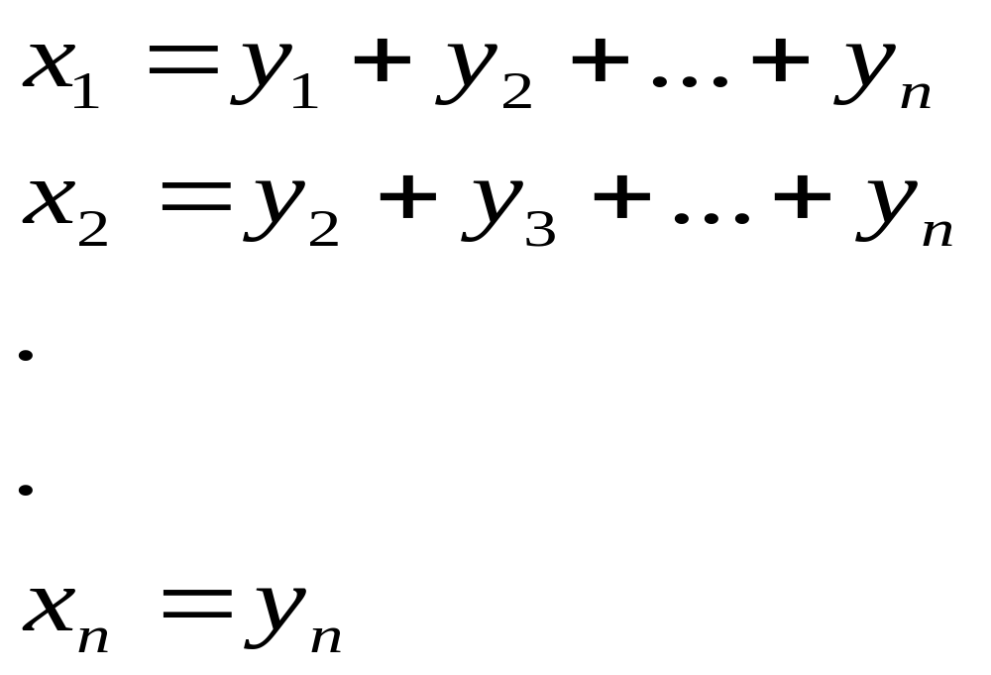
Thus there are n stages to this problem. At stage i, we have to choose the variable y_{i}. The state of the problem at stage i is defined by the variable x_{i}, which represents the sum of the variables to be decided at stages i, i+1, …, n. Thus

Slide 3
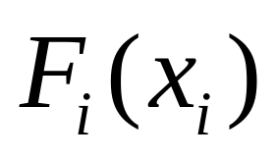
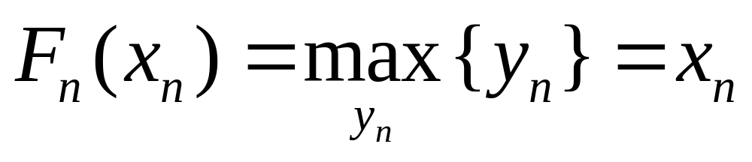
Let be the optimal return for
stages i, i+1, …, n.
Stage n: Thus x_{n} = y_{n}
Optimal return for this stage =

Slide 4
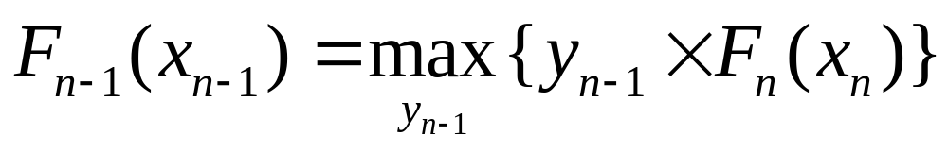
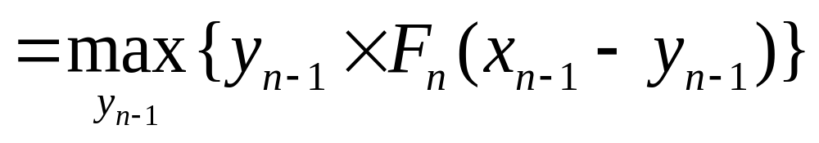
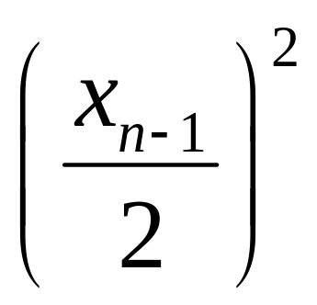
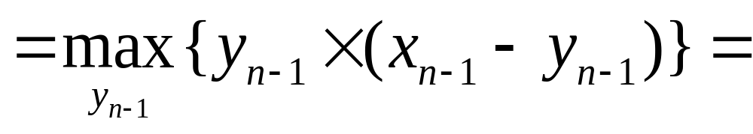
Stage n-1:
Optimal return for this stage =
occurs when y_{n-1} = (x_{n-1})/2

Slide 5
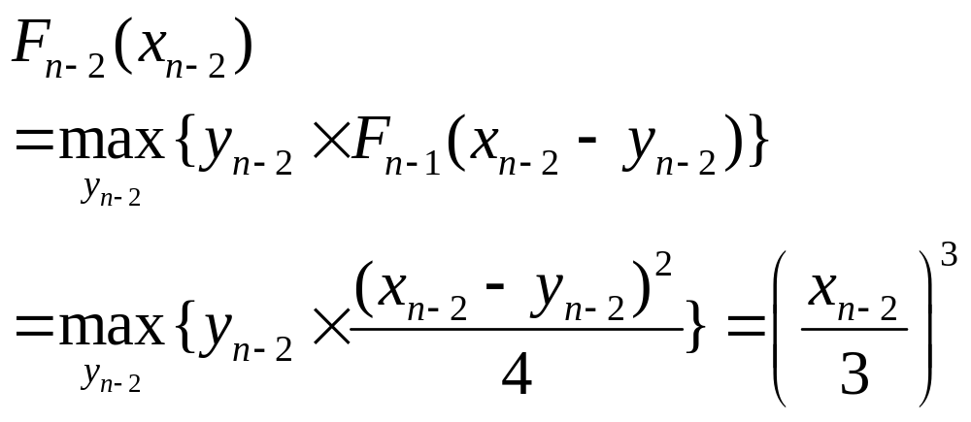
Stage n-2:
Optimal return for this stage =
occurs when y_{n-2} = (x_{n-2})/3

Slide 6
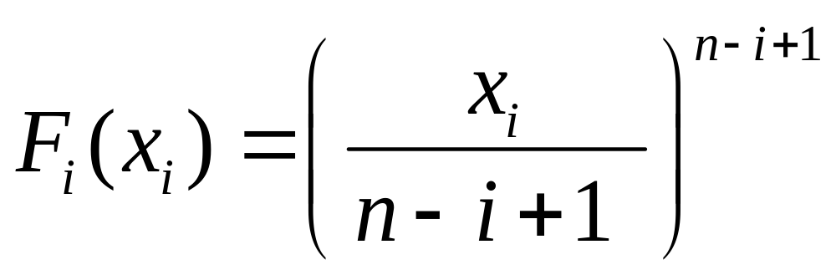
Stage i:
Optimal return for this stage (by induction on i) =
occurs when y_{i} = (x_{i})/(n-i+1)

Slide 7
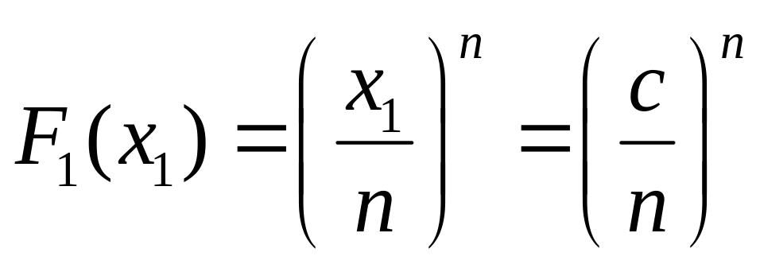
Stage 1: Optimal return for this stage =
occurs when y₁ = x₁/ n = c/ n
y₂ = x₂/(n-1) = (x₁-y₁)/(n-1)
= (c- c/n)/(n-1) = c/n
Similarly, y_{i} = c/n for all i.

Slide 8
Problem 12 Problem Set 10.3A Page 415
Maximize z = (y₁+2)²+y₂y₃+(y₄-5)²
subject to y₁+y₂+y₃+y₄ ≤ 5,
y_{i} ≥ 0, integers

Slide 9
In order to get a proper decomposition of the objective function , we rewrite it as
Maximize z = (y₁+2)²+(y₂-5)² +y₃y₄
subject to y₁+y₂+y₃+y₄ ≤ 5,
y_{i} ≥ 0, integers
Thus there are 4 stages to this problem. At stage i, we have to choose the variable y_{i}. The state of the problem at stage i is defined by the variable x_{i}, which represents the sum of the variables to be decided at stages i, i+1, …, 4.

Slide 10
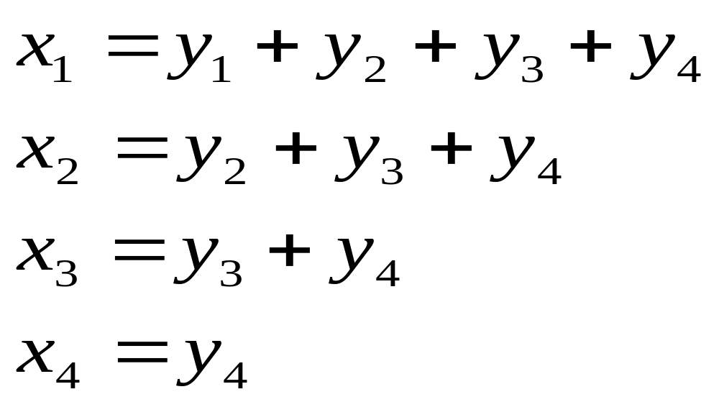
Thus
Let F_{i}(x_{i}) be the optimal return for stages i, i+1, …, 4.

Slide 11
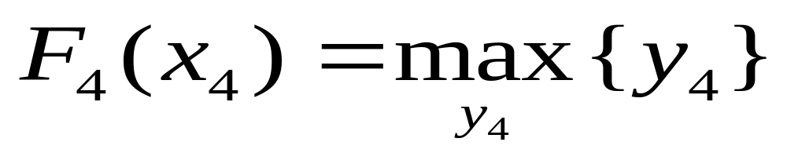
n=4 Thus x₄ = y₄ = 0,1,2,3,4
Optimal return for this stage =

Slide 12
x₄ | F₄(x₄) | y₄*
0 | 0 | 0
1 | 1 | 1
2 | 2 | 2
3 | 3 | 3
4 | 4 | 4
5 | 5 | 5

Slide 13
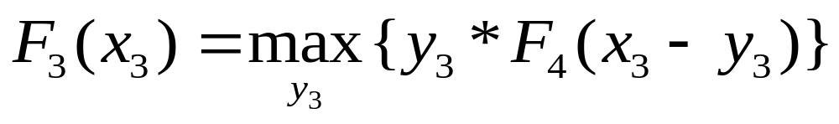
n=3 Here
y₃*F₄(x₃-y₃)
x₃ | 0 | 1 | 2 | 3 | 4 | 5 | F₃(x₃) | y₃*
0 | 0 | - | - | - | - | - | 0 | 0
1 | 0 | 0 | - | - | - | - | 0 | 0,1
2 | 0 | 1 | 0 | - | - | - | 1 | 1
3 | 0 | 2 | 2 | 0 | - | - | 2 | 1,2
4 | 0 | 3 | 4 | 3 | 0 | - | 4 | 2
5 | 0 | 4 | 6 | 6 | 4 | 0 | 6 | 2,3
y₃

Slide 14
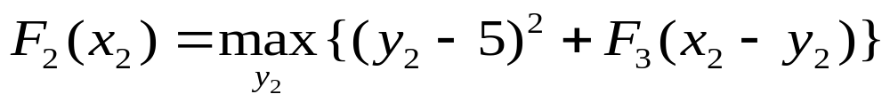

n=2 Here
y₃*f₄(x₃-y₃)
x₂ | 0 | 1 | 2 | 3 | 4 | 5 | F₂(x₂) | y₂*
0 | 25 | - | - | - | - | - | 25 | 0
1 | 25 | 16 | - | - | - | - | 25 | 0
2 | 26 | 16 | 9 | - | - | - | 26 | 0
3 | 27 | 17 | 9 | 4 | - | - | 27 | 0
4 | 29 | 18 | 10 | 4 | 1 | - | 29 | 0
5 | 31 | 20 | 11 | 5 | 1 | 0 | 31 | 0
y₂

Slide 15
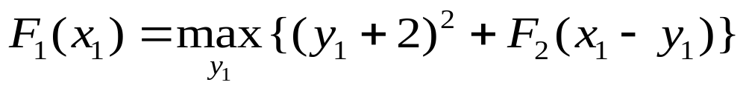

n=1 Here
y₃*f₄(x₃-y₃)
x₁ | 0 | 1 | 2 | 3 | 4 | 5 | F₁(x₁) | y₁*
0 | 29 | - | - | - | - | - | 29 | 0
1 | 29 | 34 | - | - | - | - | 34 | 1
2 | 30 | 34 | 41 | - | - | - | 41 | 2
3 | 31 | 35 | 41 | 50 | - | - | 50 | 3
4 | 33 | 36 | 42 | 50 | 61 | - | 61 | 4
5 | 35 | 38 | 43 | 51 | 61 | 74 | 74 | 5
y₁

Slide 16
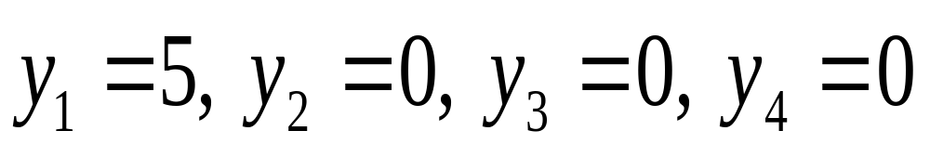
Thus the optimal solution is:
And the optimal value is z = 74

Slide 17
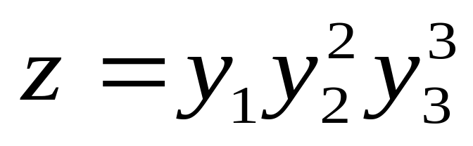
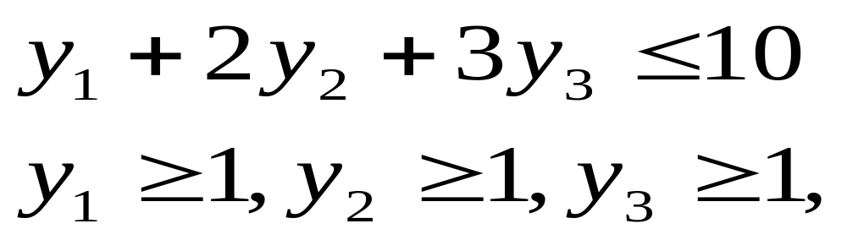
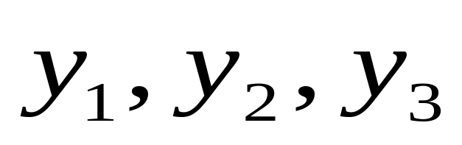
Hillier and Lieberman Problem 11.3-13 Page 573
Maximize
Subject to
and
are integers.

Slide 18
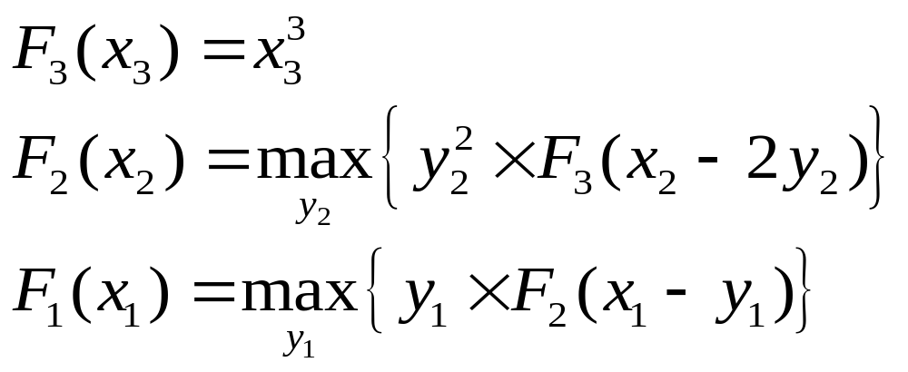
Solution: There are 3 stages; at stage i, we decide y_{i}. At stage i, the problem will be in state x_{i}, that represents the " amount " left for allocation.
If F_{i}(x_{i}) is the optimum return for stages i,i+1, …,3, then we have the following recurrence relations:

Slide 19
Stage 3
Here y₃ = 1, 2, or 3.
x₃ F₃(x₃) y₃*
0, 1, 2 0 0
3, 4, 5 1 1
6, 7, 8 8 2
9, 10 27 3

Slide 20
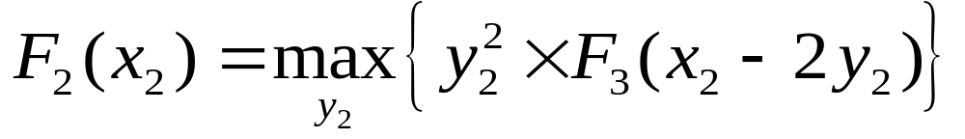
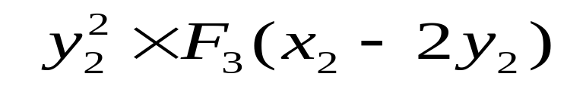
Stage 2
y₂
x₂ 1 2 3 4 5 F₂(x₂) y₂*
5 1 - - - - 1 1
6 1 - - - - 1 1
7 1 4 - - - 4 2
8 8 4 - - - 8 1
9 8 4 9 - - 9 3
10 8 32 9 - - 32 2

Slide 21
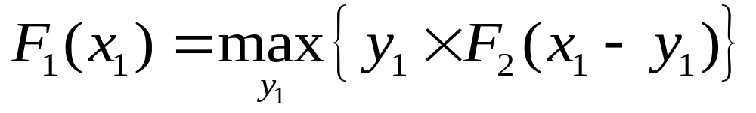
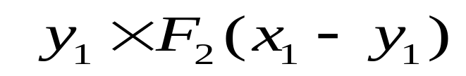
Stage 1
y₁
x₁ 1 2 3 4 5 F₁(x₁) y₁*
10 9 16 12 4 5 16 2
Thus the optimal solution is:
y₁ = 2, y₂ = 1, y₃ = 2 and optimal z = 16.

Slide 22
Brute-force Verification
SNo | y₁ | y₂ | y₃ | y₁+2y₂+3y₃ | y₁*y₂²*y₃³
1 | 1 | 1 | 1 | 6 | 1
2 | 1 | 1 | 2 | 9 | 8
3 | 1 | 2 | 1 | 8 | 4
4 | 1 | 3 | 1 | 10 | 9
5 | 2 | 1 | 1 | 7 | 2
6 | 2 | 1 | 2 | 10 | 16
7 | 2 | 2 | 1 | 9 | 8
8 | 3 | 1 | 1 | 8 | 3
9 | 3 | 2 | 1 | 10 | 12

Slide 23
SNo | y₁ | y₂ | y₃ | y₁+2y₂+3y₃ | y₁*y₂²*y₃³
10 | 4 | 1 | 1 | 9 | 4
11 | 5 | 1 | 1 | 10 | 5

Slide 24
Hillier and Lieberman Problem 11.3-10 Pages 572- 573
Consider an electronic system consisting of four components, each of which must work for the system to function. The reliability of the system can be improved by installing several parallel units in one or more of the components. The following table gives the probability that the respective components will function if they consist of one, two, or three parallel units:

Slide 25
Probability of functioning
Component
Parallel units 1 2 3 4
1 0.5 0.6 0.7 0.5
2 0.6 0.7 0.8 0.7
3 0.8 0.8 0.9 0.9
The probability that the system will function is the product of the probabilities that the respective components will function.

Slide 26
The cost (in hundreds of dollars) of installing one, two, or three parallel units in the respective components is given by the following table:
Cost
Component
Parallel units 1 2 3 4
1 1 2 1 2
2 2 4 3 3
3 3 5 4 4

Slide 27
Because of budget limitations, a maximum of $1,000 can be expended.
Use Dynamic Programming to determine how many parallel units should be installed in each of the four components to maximize the probability that the system will function.

Slide 28
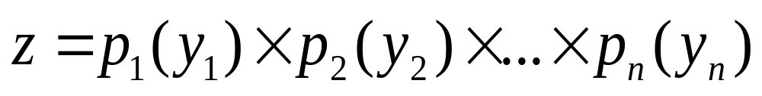
Solution: There are 4 stages. At stage i, we decide the number y_{i} of component i to be installed. At stage i, the system is in state x_{i}, namely the amount to be allocated to the stages i, i+1, …,4. All amount is in hundreds of dollars.
Our objective is to maximize the reliability of the system, namely,
where p_{i}(y_{i}) = probability of component i functioning when y_{i} number of component i are installed (and is given in the first table)

Slide 29
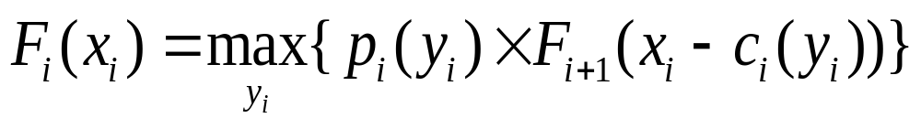
If F_{i}(x_{i}) is the optimal reliability of the system for stages i,i+1, …, 4 we then have the recursive relation
i=1,2,3,4
where p_{i}(y_{i}) = probability of component i functioning when y_{i} number of component i are installed (and is given in the first table) and c_{i}(y_{i}) is the cost of y_{i} number of component i (and is given in the second table).

Slide 30
Stage 4
x₄ F₄(x₄)= p₄(y₄) y₄*
2 0.5 1
3 0.7 2
≥ 4, ≤ 6 0.9 3

Slide 31
Stage 3
y₃ p₃(y₃) * F₄(x₃-c₃(y₃))
x3 1 2 3 F₃(x₃) y₃*
0.7x0.5
3 = 0.35 - - 0.35 1
0.7x0.7
4 = 0.49 - - 0.49 1
0.7x0.9 0.8x0.5
5 = 0.63 = 0.40 - 0.63 1
0.7x0.9 0.8x0.7 0.9x0.5
6 = 0.63 = 0.56 = 0.45 0.63 1
0.7x0.9 0.8x0.9 0.9x0.7
7 = 0.63 = 0.72 = 0.63 0.72 2

Slide 32
Stage 3 (Continued)
y₃ p₃(y₃) * F₄(x₃-c₃(y₃))
x3 1 2 3 F₃(x₃) y₃*
0.7x0.9 0.8x0.9 0.9x0.9
8 = 0.63 = 0.72 = 0.81 0.81 3
0.7x0.9 0.8x0.9 0.9x0.9
9 = 0.63 = 0.72 = 0.81 0.81 3
0.7x0.9 0.8x0.9 0.9x0.9
10 = 0.63 = 0.72 = 0.81 0.81 3
(Note: For stage 3, min x₃ = 3, max x₃ = 7.)

Slide 33
Stage 2
y₂ p₂(y₂) * F₃(x₂-c₂(y₂))
x2 1 2 3 F₂(x₂) y₂*
0.6x0.35
5 = 0.210 - - 0.210 1
0.6x0.49
6 = 0.294 - - 0.294 1
0.6x0.63 0.7x0.35
7 = 0.378 = 0.245 - 0.378 1
0.6x0.63 0.7x0.49 0.8x0.35
8 = 0.378 = 0.343 = 0.280 0.378 1
0.6x0.72 0.7x0.63 0.8x0.49
9 = 0.432 = 0.441 = 0.392 0.441 2

Slide 34
Stage 2 (Continued)
y₂ p₂(y₂) * F₃(x₂-c₂(y₂))
x2 1 2 3 F₂(x₂) y₂*
0.6x0.81 0.7x0.63 0.8x0.63
10 = 0.486 = 0.441 = 0.504 0.504 3
(Note: For stage 2, min x₂ = 5 as at least one unit of component 1 would have been installed and at least one unit of components 3 and 4 have to be installed costing at least $400; similarly max x₂ = 9)

Slide 35
Stage 1
y₁ p₁(y₁) * F₂(x₁-c₁(y₁))
x1 1 2 3 F₁(x₁) y₁*
0.5x0.441 0.6x0.378 0.8x0.378
10 = 0.2205 = 0.2268 = 0.3024 0.3024 3
Thus the optimal solution is:
y₁ = 3, y₂ = 1, y₃ = 1, y₄ = 3
And z = 0.3024

